Slide 1
Decentralized search for Shortest path approximation
Zheng Lu, Yunhe feng, Qing cao

Slide 2
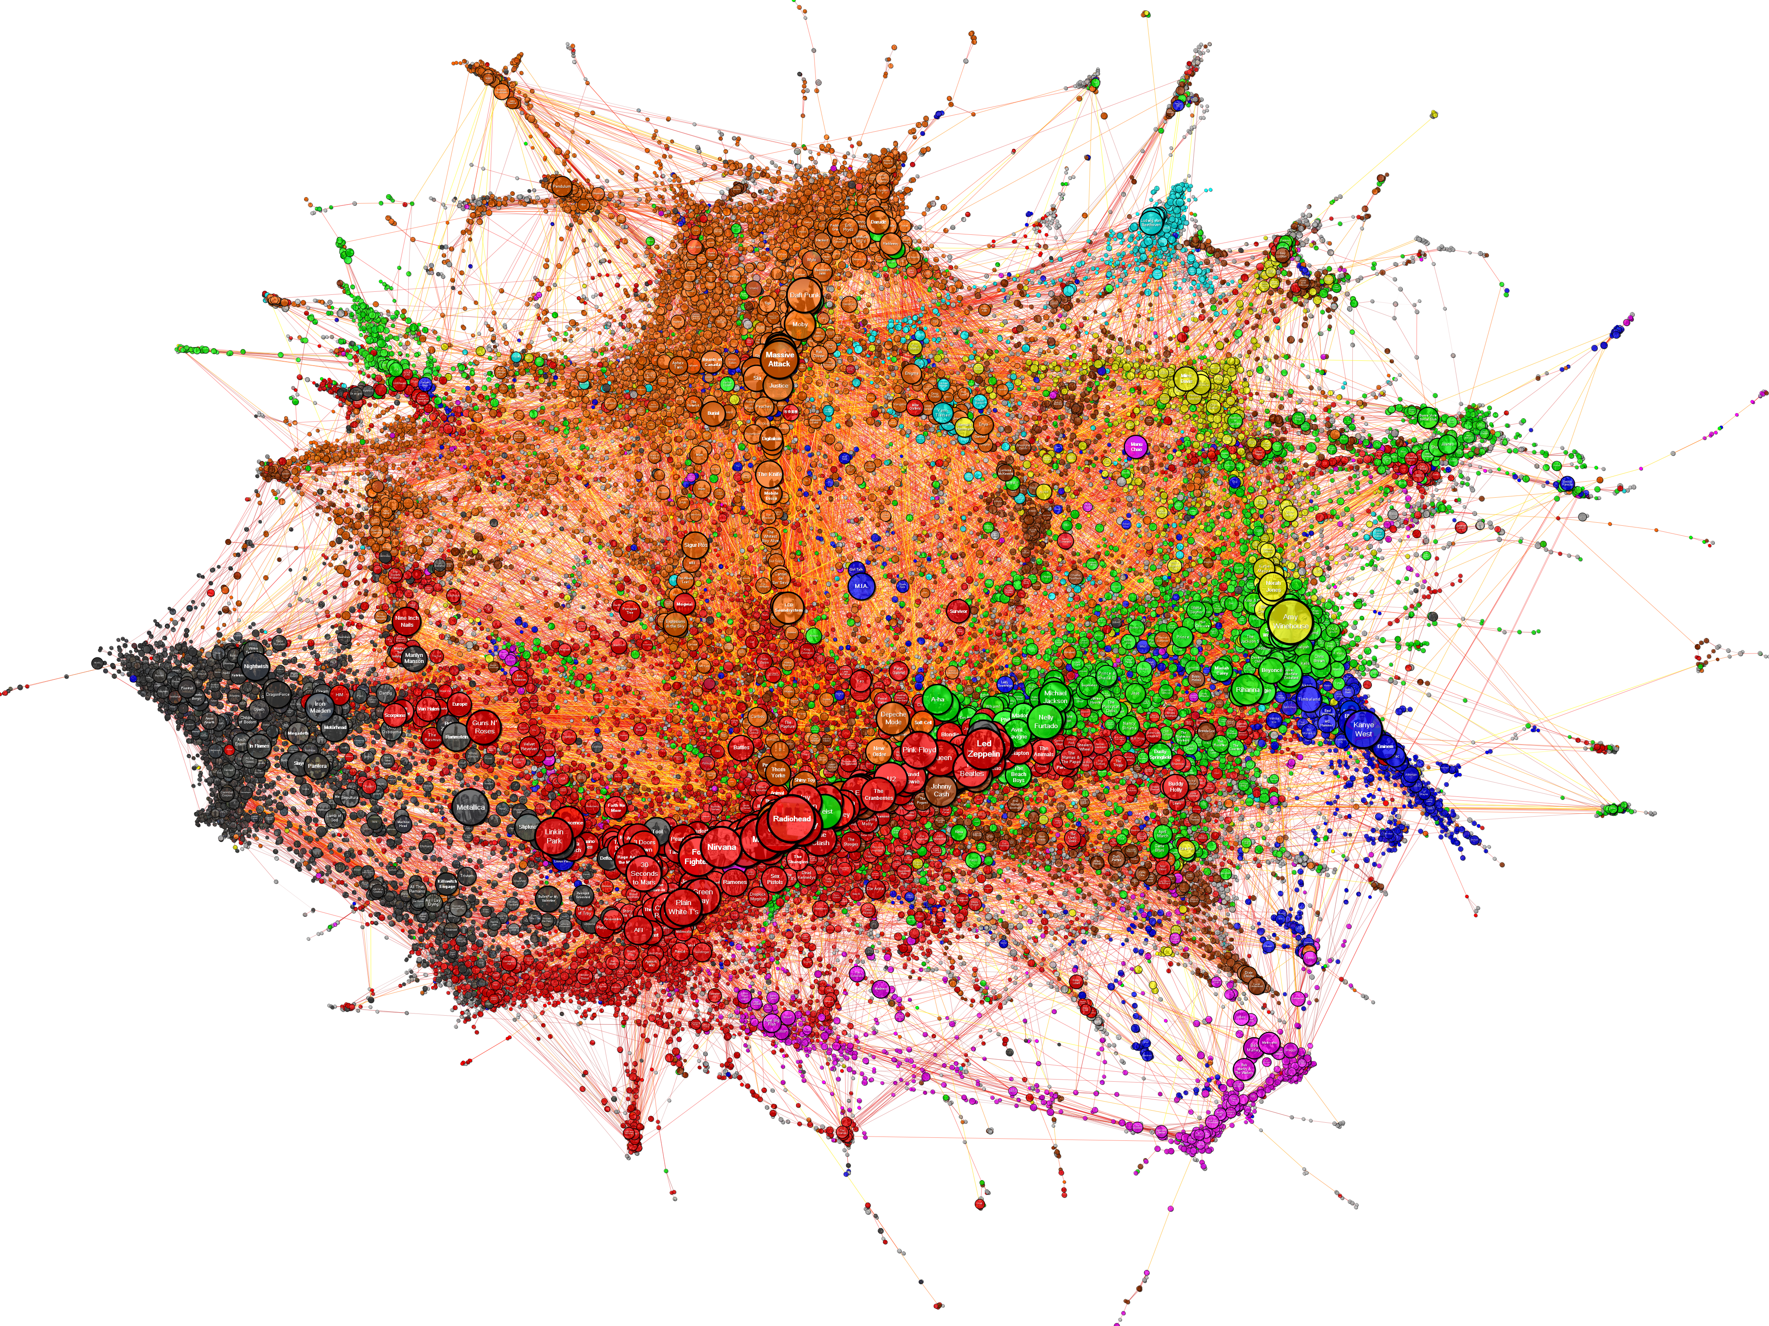
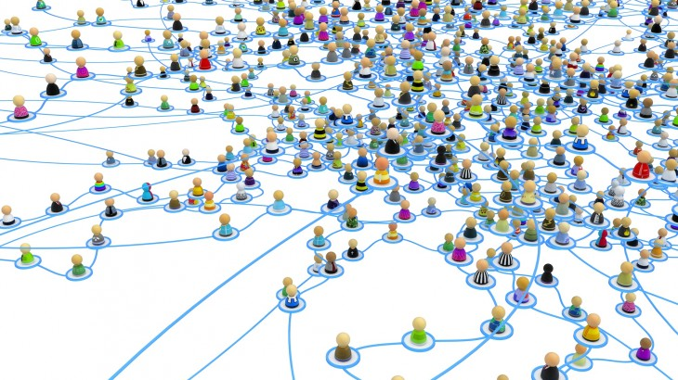
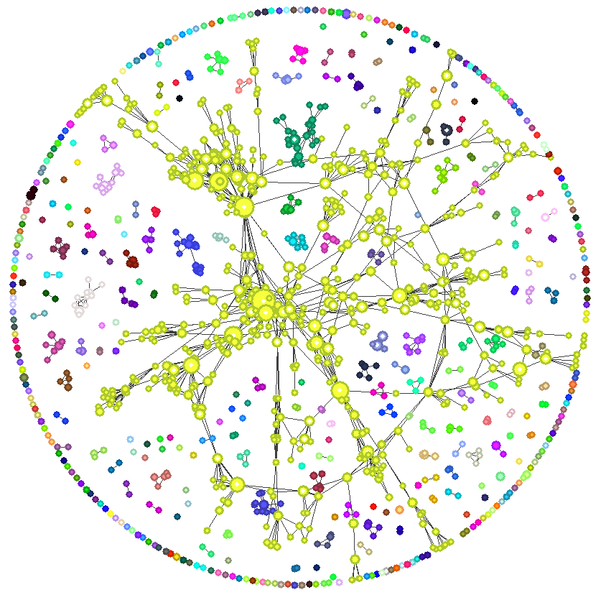
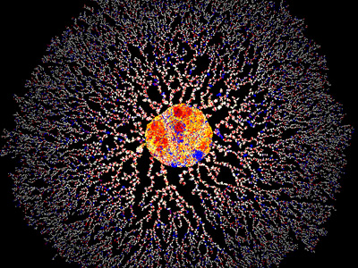
Big Graphs Are Everywhere
Social
Network[2]
Musician similarity[1]
cooperation
Network[4]
Protein homology network[3]
Notes:
Network represent relational data, we can collect this kind of data in many domain.
Music: this is a graph representation of the similarity relationships derived from the database of a music website
Protein network: Blue edges mean two proteins from the same species. Red edges mean … different …
Cooperation network shows the coauthorship between authors.
Interchangeably: Networks, are often referred to as graphs in mathematics. So we use them interchangeably in this presentation.
Large in size:
Protein: 7 million edges
Facebook: 140 billion connections (2012)
These real-world networks are not only large in size but are usually being referred to as complex networks because share some non-trivial topology features that does not exist in many other networks such as random graphs or road networks. For example, such graphs usually have power-law degree distribution and exponentially smaller diameter compared to their size.

Slide 3
Point-to-Point Shortest Path Approximation
Problem definition
Answer approximate shortest distance/path queries of any pair of vertices on large-scale complex networks
Application
Social search ranking
Estimating minimum round trip time
Etc.
Notes:
In our work, we study the problem of point-to-point shortest path.
Social search ranking: John search for a name ‘maria’, however there may be multiple users whose name matches ‘maria’. How do we present the result to John. We need a ranking system. One good way to ranking is based on the P2P distance of John to each query result.
Estimating minimum round trip time in internet: Represent the internet as a graph, we can use the shortest distance of two vertex without actually measure the minimum round trip time.
And many others.

Slide 4
Previous Works
Notes:
Exact methods are usually too slow and does not scale to large-scale graphs.
Sketch based method usually have low cost but suffer from high approximation error.
The combination of sketch and online search in previous work usually are not accurate or have high cost during online search. Also, they suffer from low path diversity.

Slide 5
Our Goal
Approximate point to point shortest path/distance with high accuracy and path diversity.
Allow parallel query processing
Suitable for vertex centric distributed platforms
Notes:
So in our work, our goal is to design a algorithm to efficiently approximate shortest path with high accuracy.
The query algorithm should be able to support parallel processing, as we see in our previous slides, applications usually use p2p shortest path as building blocks. So it’s a big plus if queries can run simultaneously.
Also, it should be fit into the distributed graph processing platforms as most graphs we dealt with cannot fit in a single machine.

Slide 6
Algorithm Structure
Preprocessing
Construct an index from the graph
Query
perform online search to extract shortest path/distance from the index and the underlying graph
Notes:
We use a two step structure for our algorithm.
First step is preprocessing, we construct an index structure from the graph. Then we perform a online search based on both the graph and the index to approximate the shortest path/distance.

Slide 7
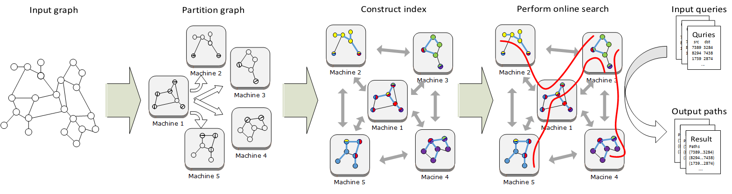
System Overview
Offline preprocessing
Online search
Notes:
We build a distributed system based on Powergraph framework to answer shortest path approximation queries in a batch processing fashion.
Here is a overview of our system.
The graph is first fed to the cluster and partitioned into several machines with vertex cut. This is done by powergraph framework.
Then the cluster runs the path degree based index construction for the graph. The indices are stored as labels for each vertex.
Once the index construction has finished, the shortest path queries can be submitted to the cluster to perform the online search.

Slide 8
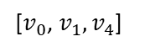
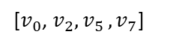
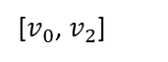

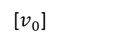
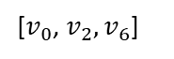
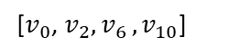
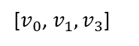
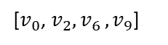
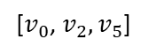
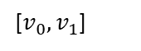
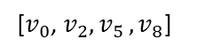
Landmark Based Index
v₀
[$v_{0}$]
Triangle Inequality:
[$v_{0}{,v}_{1}$]
LCA distance
v₂
[$v_{0}$, $v_{2}$]
v₁
$$d_{G}\left(s,t\right)≤d_{G}\left(s,lca\right)+d_{G}\left(lca,t\right)$$
v₃
v₄
v₅
v₆
[$v_{0}$, $v_{1}{,v}_{3}$]
[$v_{0}$, $v_{1}{,v}_{4}$]
[$v_{0}$, $v_{2}{,v}_{5}$]
[$v_{0}$, $v_{2}{,v}_{6}$]
v₇
v₈
v₉
v₁₀
[$v_{0}$, $v_{2}{,v}_{5},v_{7}$]
[$v_{0}$, $v_{2}{,v}_{5},v_{8}$]
[$v_{0}$, $v_{2}{,v}_{6},v_{9}$]
[$v_{0}$, $v_{2}{,v}_{6},v_{10}$]
Notes:
We adopt a well known index structure from the literature which is called landmark based index structure.
The general idea is to estimate shortest path or distance of two vertices with the help of the known shortest path or distance to another common vertex.
To generate such an index, a set of vertices are selected as landmarks. For each landmark, a shortest path tree is constructed by storing the shortest path/distance from each vertex to the landmark. For example…
It is proved that the shortest distance follows the triangle inequality rule: the distance of two vertices are bounded by the sum of distances to the landmark and the difference of distance to the landmark. For example…
It is shown in the literature that the upper bound can be used as a good shortest distance estimate.
The accuracy drops two vertices are far from the landmark but are closer to each other. For example… (v9, v10)
Such a problem can be solved by storing the shortest path to the landmark and estimate the distance with the least common ancestor. For example…
We call this kind of index as shortest path tree index. And we call the upper bound calculated from least common ancestor as the lca distance.
T is the lowest (i.e. deepest) node that has both v and w as descendants

Slide 9
Decentralized Search On Indexed Graph
Make decision based on local optimal at each step
Explore “short-cuts” in the shortest path tree index
Terminate condition
19
11
10
landmark
18
12
4
First step
neighbor:(0,1)
LCA dist to target: 4
3
9
target:(0,2,8,17)
0
5
1
2
17
13
6
7
8
22
20
14
15
16
source:(0,1,6,14)
First step
neighbor:(0,2,7)
LCA dist to target: 3
21
Notes:
Our solution is to use decentralized search based on the shortest path tree index.
So how does decentralized search work on this indexed graph?
Starting from the source vertex, at each step, the algorithm traverse the neighbor vertices and pick the one with shortest lca distance.
The search will terminate as long as two vertices are connected (share common vertices in their label). There will always be a candidate for next step in the label of current vertex with a shorter lca distance than current vertex. And that vertex will lead to a path to the target vertex.
The search terminates when it reaches any vertex in the shortest path from the target vertex to the landmark. As shortest paths follow optimal substructure, that any path along a shortest path is also a shortest path itself. For example..

Slide 10
Decentralized Search - Search Space
Bidirectional search
Tie breaking
First step neighbor for both :(0,4,12)
LCA dist to target: 4
LCA dist to source: 2
source:(0,4,11)
First step
neighbor:(0,3,10)
LCA dist to targert: 4
source:(0,3,9,18)
19
11
10
19
11
10
First step neighbor of forward search:(0,4)
LCA dist to target: 3
18
12
18
12
4
4
3
3
9
First step
neighbor:(0,3,9)
LCA dist to targert: 4
9
0
5
1
0
5
1
2
17
2
17
13
First step neighbor of backward search:(0,1)
LCA dist to source: 3
13
6
7
8
22
6
7
8
22
20
16
20
14
15
14
15
16
target:(0,1,5)
21
target:(0,2,8)
21
Notes:
It is a common technique to perform bidirectional search for BFS to reduce the search space, i. e. the number of edges to be traversed.
While bidirectional decentralized search guided by shortest path tree index is not symmetric in the sense that the forward search and backward search may find very different paths. The difference is cause by that the search space of forward search and backward search may or may not overlap as the search space is dynamically discovered at each step on a greedy way. For example…
For each landmark, it is very common that multiple vertices have the same lca distance to the a single vertex. This implies that during each step of decentralized search, the algorithm is very likely to find ties between multiple neighbor vertices. This gives the search opportunities to further expand the search space for more accurate estimates, however, at the cost of more computing resource. For example, … both vertex 9 and vertex 10 have same … Without further exploring, it is impossible to decide which one can lead to a shorter path. In our distributed implementations, we fork the search into multiple individual searches to explore the search space when tie happens. The algorithm dynamically control the number of children searches with the system load. (We’ve tested several different heuristics, how ever, they all achieve similar performances.)
We have two basic tie break strategies:
Single branch, the search will randomly pick a neighbor from all neighbors with the shortest LCA distance to the target as the next hop candidate
Full branch, the search will pick all neighbors with the shortest LCA distance to the target as the next hop candidate

Slide 11
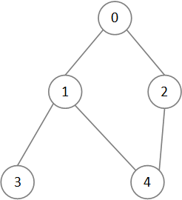
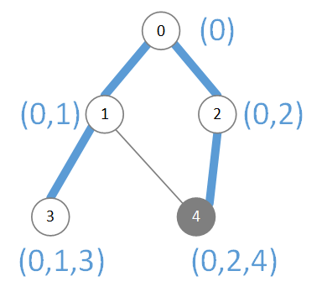
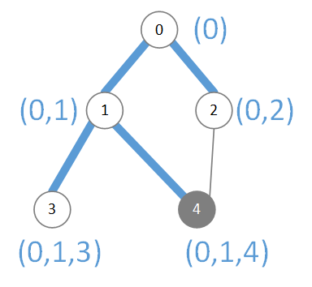
Preprocessing - Index Construction
The performance of decentralized search is highly affected by the index
Tighter bound means better distance estimates
How to achieve tighter bounds when construct shortest path tree index
Total LCA distance from 4 to all other vertices: 10
Total LCA distance from 4 to all other vertices: 8
Notes:
At each step, decentralized search solely rely on the lca distance to choose which neighbor vertices to go on next step.
As we mentioned before, the lca distance is an upper bound of shortest distance between two vertices.
If we can produce tighter upper bound when build the index, we can have better distance estimates during the search.
How can we build a shortest path tree index that can provide tighter bounds?
I want to show you an example first. Here is a very simple graph with only 5 vertices. Let’s assume that vertex 0 is chosen as the landmark. So there are two ways to construct a shortest path tree index as listed here.
And for both index, there is only one vertex, vertex 4, that has different labels.
Let me show you the sum of lca distance from vertex 4 to all the other vertices in the graph.
As you can see…
Since the underlying graph is the same, the sum of actual shortest distance from vertex 4 to all the other vertices is the same.
So the second one gives a tighter upper bound on average.
Why is that.
By building the index like the right one, the vertex 4 is closer to more other vertices in the sense of lca distance.
So how to generalize this to a larger graphs, when we can not afford to calculate the exact lca distance between every pair of vertices.

Slide 12
Preprocessing - Path Degree based Index (PDI) Construction
Path degree
Store the shortest path with highest path degree
BFS based shortest path tree index construction
Notes:
Normally when we build a shortest path tree index, we traverse the graph with BFS, and assign each vertex a label of the shortest path to the landmark for the first time the search discover it. For example, 7,8,9 …
Later when we reach it again from another vertex at a lower level, the algorithm just ignore it. For example… 4 to 8
Different ways of build the index actually means different shortest path from the landmark to be stored in each vertex.
So for each vertex, we want to pick a shortest path that has higher level of centrality so that they have shortest average lca distance to the rest of the graph.
Ideally, we should use the closeness centrality based on lca distances. But this is very expensive to compute.
So we seek to degree as an alternative and they perform very well in practice.
So for each path, we defined a new metric call path degree, that is simply the sum of the degree of vertices along the path.
When we build the index, for each vertex, we just need to store the shortest path from the landmark with the highest path degree.
We can do this by modifying the regular index construction procedure a little bit.
For each vertex, we add a variable that store the path degree of the stored shortest path. Then later, when the vertex is discovered from another shortest path, the algorithm compare the path degree of both shortest path and replace the label with the new shortest path if necessary.

Slide 13
Distributed And Parallel Implementation
Light weight:
time complexity: O(k * σ_{max}² * δ_{max})
space complexity: O(k * σ_{max})
σ_{max} is diameter, δ_{max} is max degree, k is number of landmarks
Millions of searches can be carried out in parallel
Well suited for vertex centric programming model
Gather, Apply, Scatter
Notes:
Now, we talk about the implementation of the work. It can be proved that the decentralized search terminates in at most 2 * diamter steps, and at each step, the search only examine it’s neighbors for lca distance to the target.
So we have time complexity that is bounded by the diameter of the graph and maximum vertex degree. It’s much faster compared to BFS.
Consider the average shortest distance for most complex networks is very small. And the large degree vertices are usually avoided by the termination condition. The search are usually finished really fast in practice.
Also, as the search only carries the label of the target vertex and the approximated path, so the space complexity is bounded by the diameter of the network. This is very small compared to the BFS which requires space that is linear to the size of the graph.
The small memory cost for each search gives opportunity for large amount of independent search to run in parallel. Actually in our experiments, a cluster consist of 20 commodity computers can support up to millions of independent searches to run simultaneously.
The decentralized search is also very suitable for vertex centric programming model. Details in next slides

Slide 14
Distributed And Parallel Implementation
Vertex centric programming model use vertex programs consist of three phases for each search step:
Gather: LCA distances from each neighbor to targets (for multiple queries) are collected and are reduced to one(s) with shortest LCA distance for each query
Apply: The estimated path for each query is updated
Scatter: The next step candidate(s) are chosen based on tie break strategy. The algorithm activate the next step neighbor.
Notes:
Each step of computation consist of three phase, gather, apply and scatter. In gather phase, the search compute lca distance to target vertices and a reduce function is used to return one or multiple neighbors with the shortest lca distance to the target. The estimate path is updated in the apply phase, and in the scatter phase, the selected neighbors are activated and the estimated path is sent to them.

Slide 15
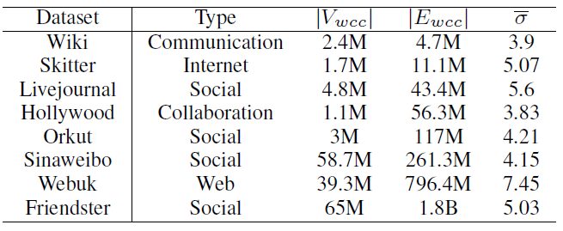
Settings
Dataset
20 EC2 m4.xlarge (4-vCPU, 16GB RAM) nodes
Notes:
We perform extensive experiments on 8 complex networks from different domains.

Slide 16
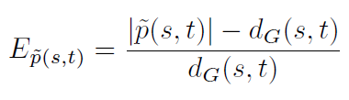
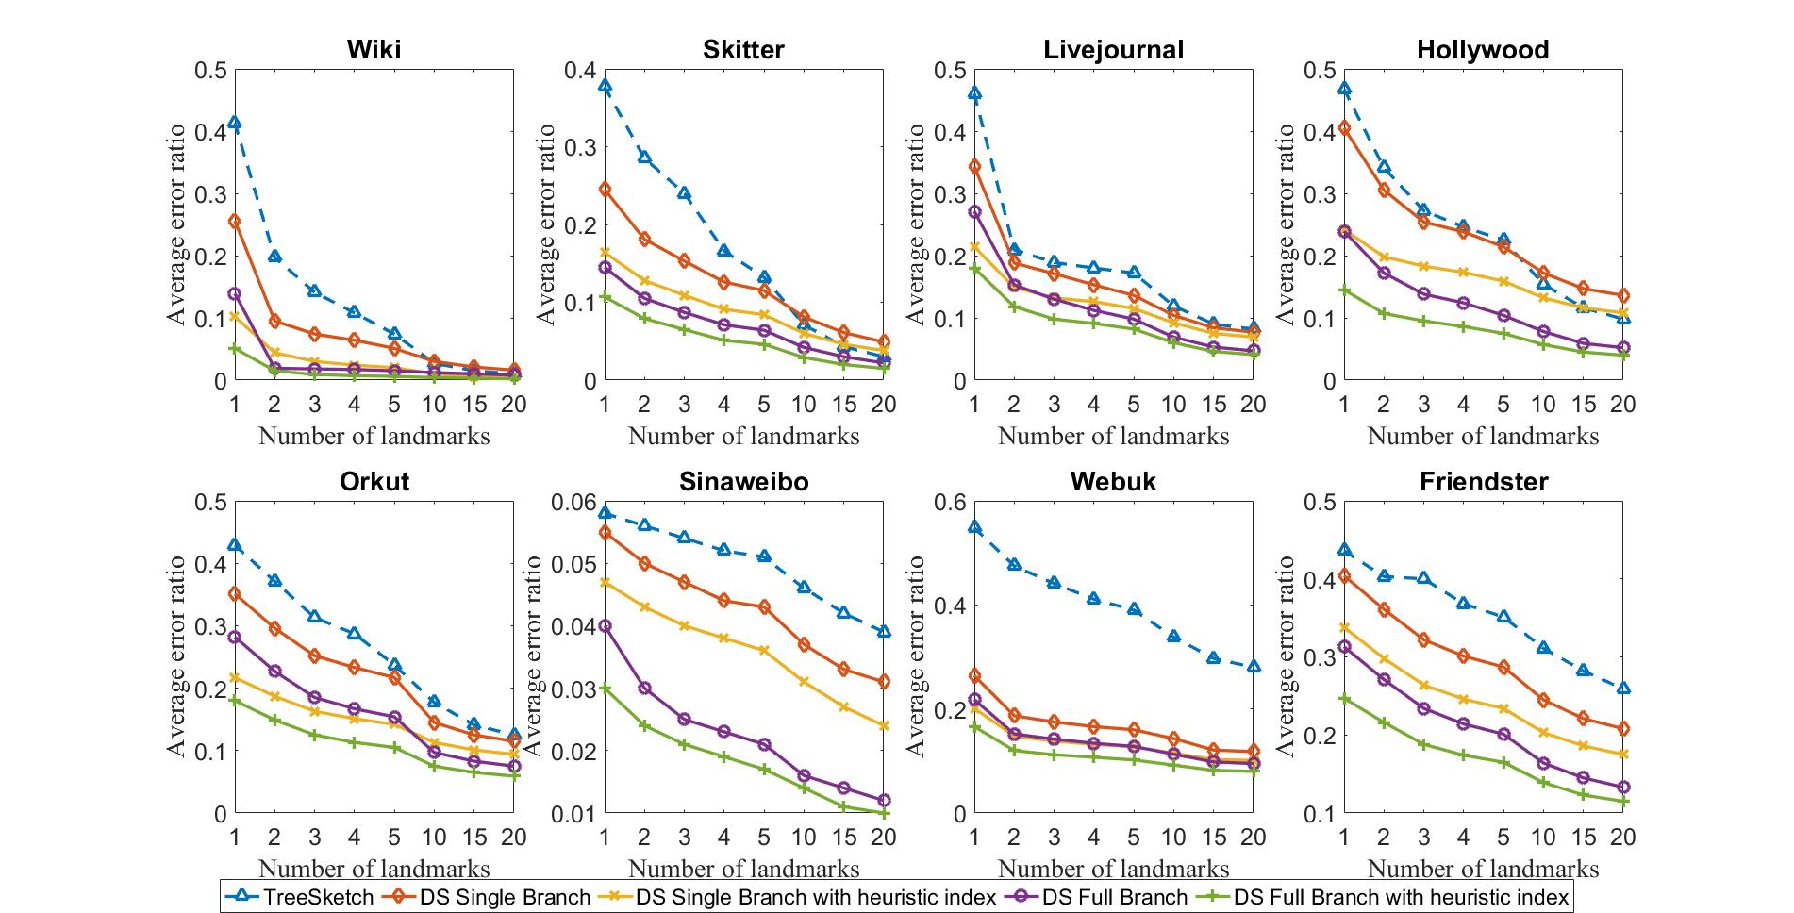
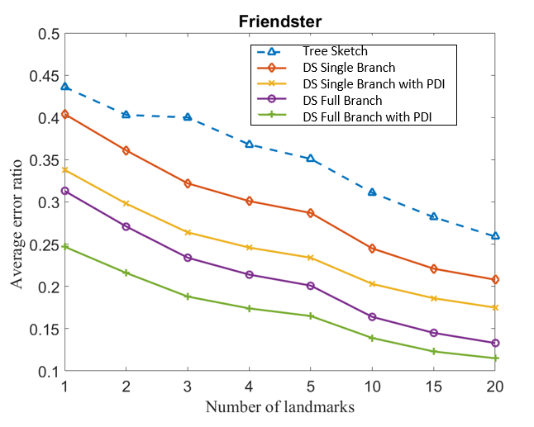
Performance - Accuracy
Error ratio:
Baseline work from [CIKM ’10, TKDE ‘14]
Notes:
PDI is short for Path Degree based Index.
We compare out work with the stat-of-art in the literature and show the results here.
In this figure, we show the average (arithmetic mean) error rate for each approach. We define the error rate as the difference between estimated path length and exact shortest path length, divided by the exact shortest path length.
Lets focus on one figure for the ease of illustration.
The x axis is the number of landmarks and the y axis is the average error ratio calculated from 100 thousand queries.
There are five approaches in total including the baseline approach.
To show the effect of tie breaking strategies, we take two extreme approaches in our experiment. The first one only explore a single vertex when tie happens, we call it single branch strategy, and the second one explores all the vertices with the same smallest lca distance when tie happens, we call it full branch strategy.
We also show the result of decentralized search perform on indices generated by normal BFS or modified BFS.
This figure illustrates the effectiveness of both expanding search space and use modified BFS when building the index.
Not only our accuracy outperforms the baseline work. Our approximated shortest paths are much diverse than the baseline work.

Slide 17
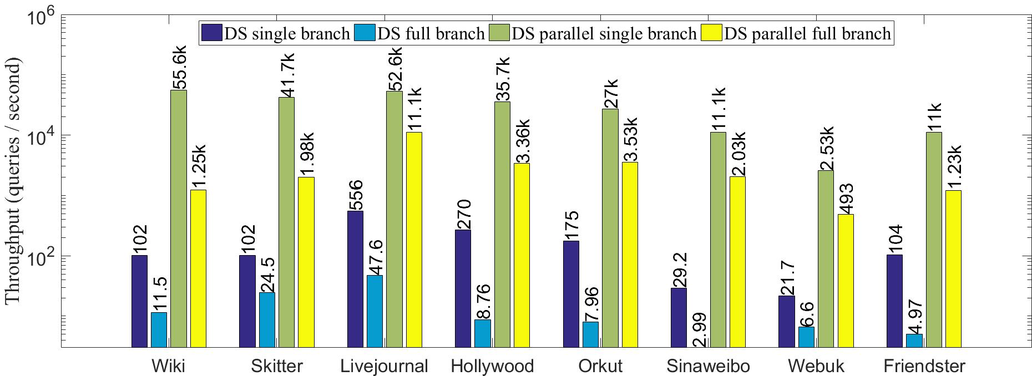
Performance - Throughput
Notes:
In this figure, we show the throughput of our system.
We use both simple implementation on a single machine without parallel execution and our distributed system with parallel execution.
The distributed system consist of 20 commodity machines, each with a 4-core cpu and 16GB memory.
(Note that due to the size of the graphs, for single machine implementation, we have to use a much powerful machine with very large memories (256 GB))
For each setting, we tested both single branch and full branch tie strategy.
The x axis if for different approaches on different graphs.
The y axis is the throughput which is queries per second. Note that this axis is in log scale.
We can see that for both tie breaking strategies, the distributed and paralleled version has 2 to 3 order higher throughput.

Slide 18
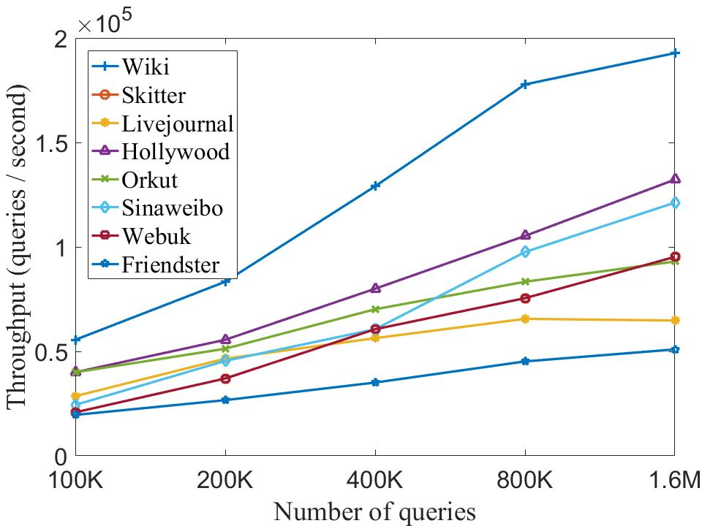
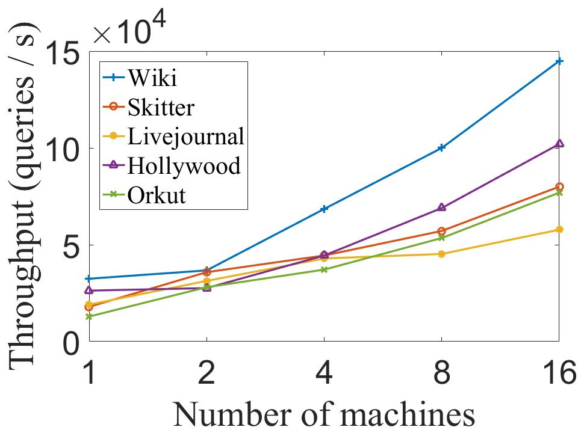
Performance - Scalability
Notes:
Now we show the scalability of our system.
The left figure shows the throughput when different number of query run in parallel. The experiments are carried on 20 machines. We can see the
constant growth of throughput as the number of queries running simultaneously increases. The growth of throughput slows down for large number of queries as the system limits
are reached, i.e., memory size or network bandwidth. The throughput for 1,600,000 queries running simultaneously is 2.3 to 5.0 times higher than it for 100,000 queries.
The right figure are based on the results of running 1,000,000 queries simultaneously. The throughput on 16 machines is 3.0 to 5.9 times higher than on a single machine for various graphs. Note that we do not have results for the 3 largest graphs as they are not able to fit into fewer than 8 machines.

Slide 19
References
[1] http://www.vislives.com/2012/01/more-lastfm-data-visualizations.html
[2] https://thenextweb.com/socialmedia/2013/11/24/facebook-grandparents-need-next-gen-social-network/
[3] http://www.visualcomplexity.com/vc/project.cfm?id=122
[4] http://cmxp.bplaced.net/Commetrix/iris/iris.html
[SODA ‘02] Cohen, Edith, et al. "Reachability and distance queries via 2-hop labels." SIAM Journal on Computing 32.5 (2003): 1338-1355.
[SIGMOD’10] Wei, Fang. "TEDI: efficient shortest path query answering on graphs." Proceedings of the 2010 ACM SIGMOD International Conference on Management of data. ACM, 2010.
[CIKM ‘09] Potamias, Michalis, et al. "Fast shortest path distance estimation in large networks." Proceedings of the 18th ACM conference on Information and knowledge management. ACM, 2009.
[WSDM ‘10] Das Sarma, Atish, et al. "A sketch-based distance oracle for web-scale graphs." Proceedings of the third ACM international conference on Web search and data mining. ACM, 2010.
[CIKM ‘10] A. Gubichev, S. Bedathur, S. Seufert, and G. Weikum. Fast and accurate estimation of shortest paths in large graphs. In Proceedings of the 19th ACM International Conference on Information and Knowledge Management, CIKM ’10, 2010.
[TKDE ‘14] M. Qiao, H. Cheng, L. Chang, and J. Yu. Approximate shortest distance computing: A query-dependent local landmark scheme. Knowledge and Data Engineering, IEEE Transactions on, 2014

Slide 20
Thank you!

Slide 21
Appendix 2 - Complex Networks
Non-trivial topology features:
Power-law degree distribution
Small world property
More than 10⁸ vertices have one neighbor.
Top 1% of vertices are adjacent to
50% of the edges!
Number of Vertices
AltaVista WebGraph
1.4B Vertices, 6.6B Edges
Degree
Figure from [OSDI ‘12]
Notes:
Non-trivial topology features: These real-world networks are not only large in size but are usually being referred to as complex networks because share some non-trivial topology features that does not exist in many other networks such as random graphs or road networks.
Most common feature: Here I listed the most common topology features which are power-law degree distribution and small world property.
Here we have degree distribution for a web graph collected in 2002. Degree means the number of edges adjacent to a vertex.
More than 100 millions of vertices have a degree of 1. And the top 1% of vertices that are adjacent to 50% of edges.

Slide 22
Appendix 3 - Power-law Graph - Vertex Centric Model
Power-law graphs do not have low-cost balanced edge cuts [WWW ‘08]
Gather, Apply, Scatter
Machine 1
Machine 2
Machine 1
Machine 2
Figure from [OSDI ‘12]
Notes:
Distributed, new challenge: The distributed graph processing systems are required to handle graphs at this scale. And powerlaw degree distribution present new chanllenges for graph processing systems
Performance rely on partition: The performance of distributed graph process platforms highly rely on the partition of the graph.
Tradition partition scheme split the graph into several subgraphs of approximately equal size by cutting edges.
Communication overhead, powerlaw: The communication overhead are decided by the number of edge cuts.
However, graphs with power-law degree distribution makes it very hard to find a good cut because the existance of high degree vertices.
No low-cost cut: To solve this problem, a new programming model called vertex centric model is proposed.
In this model, computation carried on each vertex only when it is activated. For each computation cycle, there are three phases call gather, apply and scatter. For example in pagerank, when a vertex is activated, it first gather it’s neighbors’ pagerank, then it use a sum operation to reduce the gathered information to a scalar and update its own pagerank based on it’s neighbor’s pagerank. Then it activates it’s neighbor vertices to update their pagerank.

Slide 23
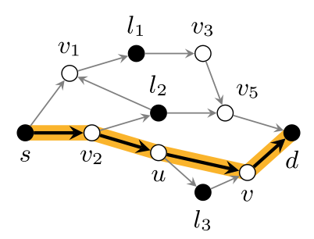
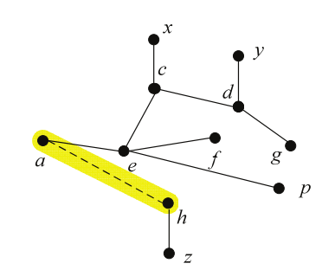
Appendix 3 - Problem with existing work
Expended tree
Tree sketch
Low path diversity
High cost for power-law graphs
Figure from [CIKM ’10, TKDE ‘14]
Notes:
However, in real world graphs there are edges that cannot be included in the shortest path tree index.
Such a edge can be a short cut when searching for shortest paths.
To solve this problem, existing work expand the shortest path tree index in different fashion.
The tree sketch from CIKM 10 find shortest path by create a smaller graph with labels of source and target vertex and then perform BFS on this small graph to approximate shortest path.
However, in this way, the path diversity is very low as vertices only in the labels of source and target vertices can be included in the resulting path.
The expended tree from TKDE 14 expand the shortest path tree index by discover it’s neighbors. However, due to the nature of power-law graphs, they expanded tree will cause the search space explode as the neighbors of too many unnecessary vertices are expanded.

Slide 24

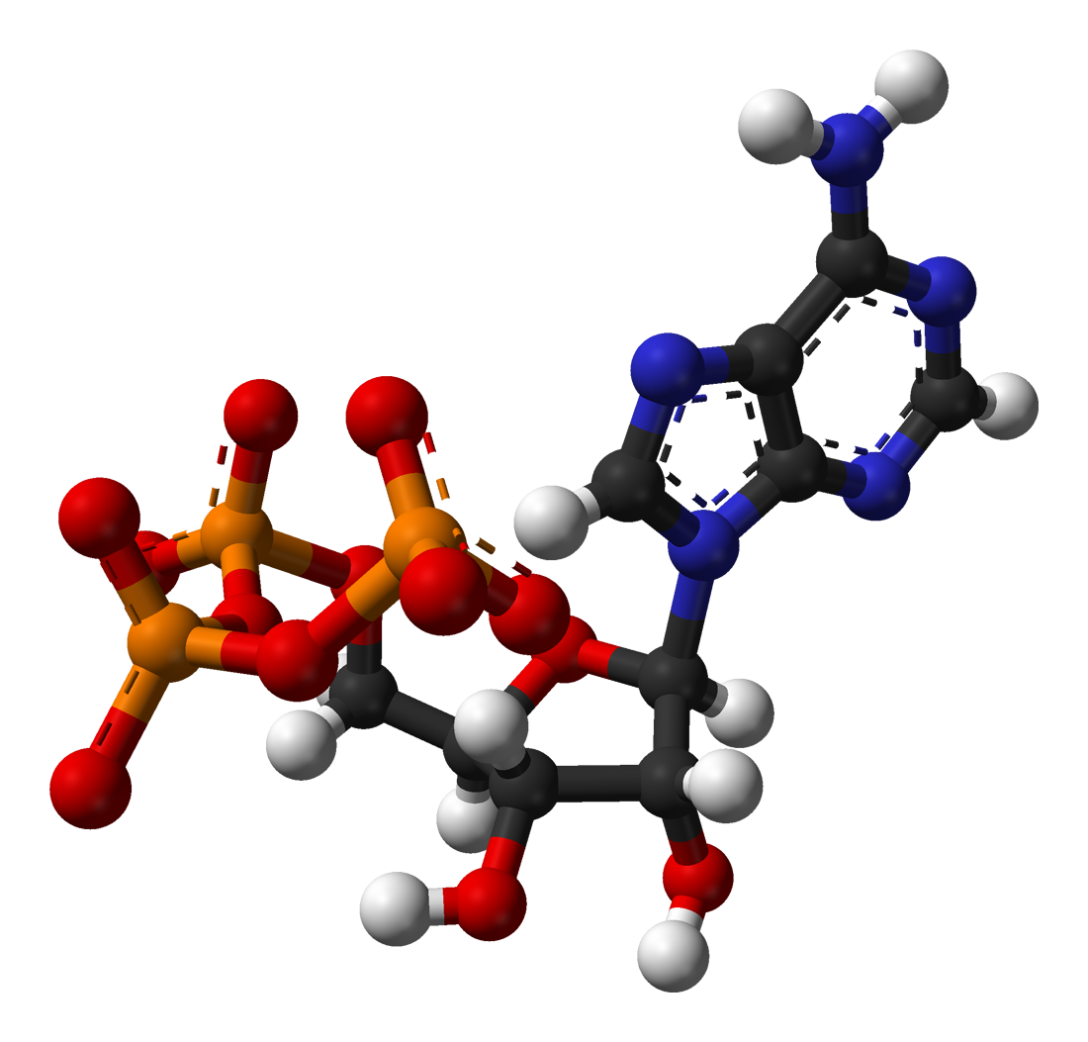


Appendix 4 - Small World Property
“Small-world” experiments
Most real world networks are small world networks
Decentralized search [Nature ‘00]
Social
Science
Advertising
Web
4.7
6.8
7.6
8.1
Notes:
The small world property was first discovered through an interesting experiment carried in 1960s.
A group of people is asked to transmit letters from Nebraska and to a specific stranger in Boston. The name and several items of information about the target person are provided to guide each sender.
The letters are not directly sent to the target person.
For each people, the letter can only be forwarded to someone he/she know on a first-name basis.
To forward the letter, a greedy heuristic is used at each step. People are asked to forward the letter to a person that most likely related the target person based on the available information of the target.
Each person write down their names on the letter for tracking purpose.
Most of letters are discarded during the process. While some of the letters reached the target people (around 30%).
The successfully delivered letters have passed on average through only about 5.2 persons.
This implies that the average shortest path of the underlying social network is quite small.
You can see that on various kinds of networks, the average shortest path ranges from only 4 to 8, which is exponentially smaller than their size.
The greedy heuristic, that forward the letter to a person that most likely related to the target person, are later discussed by Jon Kleinberg and refer to as decentralized search.

Slide 25
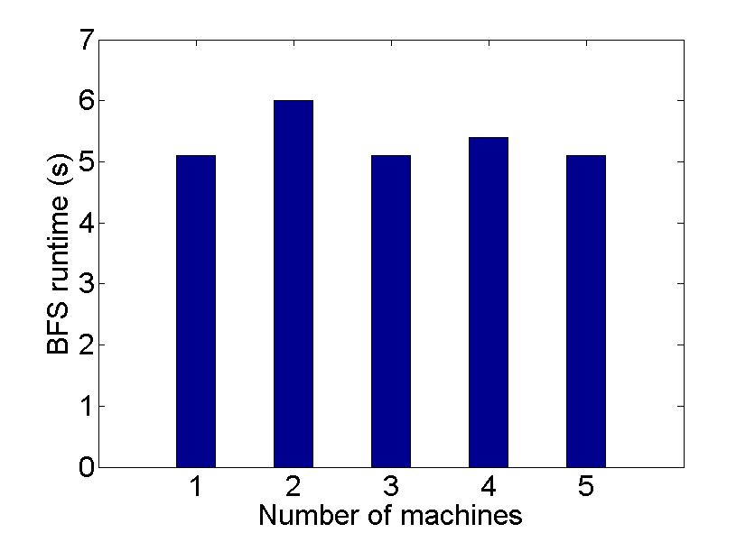
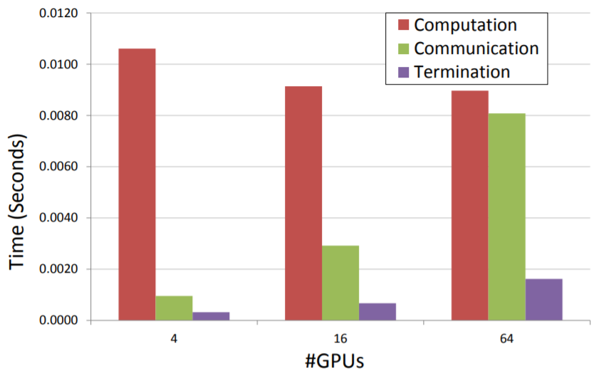
Appendix 5 - Why not BFS?
GPU Figure from [Big Data ‘14]
Notes:
Figure from the left is a figure I draw a few years ago, with a group of EC2 virtual machines (xlarge, 4 virtual cores, 10G low lantency ethernet) and running Powergraph which is the state-of-the-art vertex-centric platform at that time.
Implement BFS in as vertex-centric programs on Powergraph and change the number of computing nodes to run BFS on a graph with 68 million edges.
The number of machines varies from 1 to 5. However, the total run time is very similar with various machines, they are all around 5 seconds.
When I make this slides a few weeks ago, I looked up the performance of BFS in HPC community as they have most powerful machines and BFS is a standard benchmark such as Graph 500.
On a 64 GPU(K20) Cluster, a 4B edge graph takes 0.15 (one-sixth) second to finish a full BFS traversal.
Memory cost is high, you need to record which vertices are visited and which are not.

Slide 26
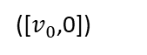
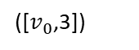
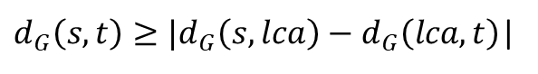

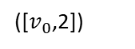
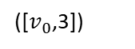

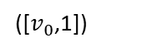
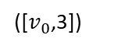
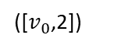
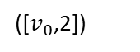
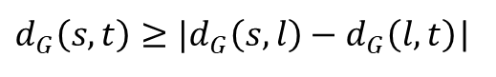
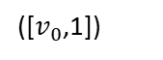
Appendix 6 - Landmark Based Index (with animation)
v₀
[$v_{0}$]
v₀
([$v_{0}$,0])
Triangle Inequality:
$$d_{G}\left(s,t\right)≤d_{G}\left(s,l\right)+d_{G}\left(l,t\right)$$
[$v_{0}{,v}_{1}$]
v₂
([$v_{0}$,1])
[$v_{0}$, $v_{2}$]
v₂
v₁
([$v_{0}$,1])
v₁
$d_{G}\left(s,t\right)≥|d_{G}\left(s,l\right)−d_{G}\left(l,t\right)$|
v₃
v₄
v₃
v₄
LCA distance
v₅
v₆
v₅
([$v_{0}$,2])
v₆
[$v_{0}$, $v_{1}{,v}_{3}$]
([$v_{0}$,2])
[$v_{0}$, $v_{2}{,v}_{5}$]
[$v_{0}$, $v_{2}{,v}_{6}$]
([$v_{0}$,2])
[$v_{0}$, $v_{1}{,v}_{4}$]
$$d_{G}\left(s,t\right)≤d_{G}\left(s,lca\right)+d_{G}\left(lca,t\right)$$
v₇
$d_{G}\left(s,t\right)≥|d_{G}\left(s,lca\right)−d_{G}\left(lca,t\right)$|
v₈
v₉
v₁₀
v₇
v₈
v₉
v₁₀
[$v_{0}$, $v_{2}{,v}_{5},v_{7}$]
([$v_{0}$,3])
([$v_{0}$,3])
([$v_{0}$,3])
([$v_{0}$,3])
[$v_{0}$, $v_{2}{,v}_{5},v_{8}$]
[$v_{0}$, $v_{2}{,v}_{6},v_{9}$]
[$v_{0}$, $v_{2}{,v}_{6},v_{10}$]
Notes:
We adopt a well known index structure from the literature which is called landmark based index structure.
The general idea is to estimate shortest path or distance of two vertices with the help of the known shortest path or distance to another common vertex.
To generate such an index, a set of vertices are selected as landmarks. For each landmark, a shortest path tree is constructed by storing the shortest path/distance from each vertex to the landmark. For example…
It is proved that the shortest distance follows the triangle inequality rule: the distance of two vertices are bounded by the sum of distances to the landmark and the difference of distance to the landmark. For example…
It is shown in the literature that the upper bound can be used as a good shortest distance estimate.
The accuracy drops two vertices are far from the landmark but are closer to each other. For example… (v9, v10)
Such a problem can be solved by storing the shortest path to the landmark and estimate the distance with the least common ancestor. For example…
We call this kind of index as shortest path tree index. And we call the upper bound calculated from least common ancestor as the lca distance.
T is the lowest (i.e. deepest) node that has both v and w as descendants

